Slide 1
Secondary Storage Management
Dr. Manmath N. Sahoo
Dept. of CSE, NIT Rourkela

Slide 2
Allocation Methods
Allocation methods address the problem of allocating space to files so that disk space is utilized effectively and files can be accessed quickly
Three methods exist for allocating disk space
Contiguous allocation
Linked allocation
Indexed allocation

Slide 3
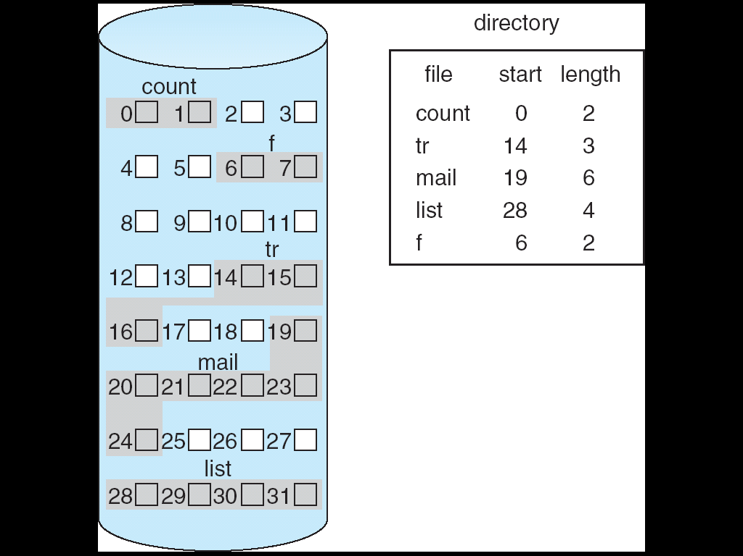
Contiguous Allocation
Requires that each file occupy a set of contiguous blocks on the disk
Accessing a file is easy

Slide 4
Contiguous Allocation: Issues
Internal fragmentation
External fragmentation
Need for compaction, which is time consuming
Finding space for a new file (first fit, best fit, etc.)
Determining space for a file, especially if it needs to grow
Allocating too little space – if file grows then copy it to a larger free hole – time?
Allocating too much space – if the file doesn’t grow – large number of smaller holes
Even if we know the size of the file prior to the allocation, pre-allocation may be inefficient – file may grow very slowly over a long period of time

Slide 5
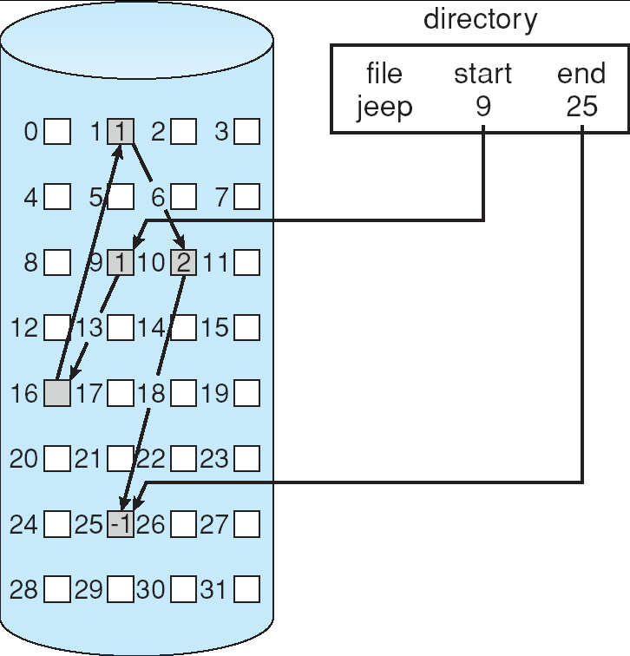
Linked Allocation
Solves problems of contiguous allocation except internal fragmentation
Each file is a linked list of disk blocks: blocks may be scattered anywhere on the disk
The directory contains a pointer to the first and last blocks of a file

Slide 6
Linked Allocation
Creating a new file requires only creation of a new entry in the directory
Writing to a file causes the free-space management system to find a free block
This new block is written to and is linked to the end of the file
Reading from a file requires only reading blocks by following the pointers from block to block

Slide 7
Linked Allocation
Advantages
There is no external fragmentation
Any free blocks on the free list can be used to satisfy a request for disk space
The size of a file need not be declared when the file is created
A file can continue to grow as long as free blocks are available
It is never necessary to go for compaction

Slide 8
Linked Allocation
Disadvantages
Can only be used effectively for sequential access of files
It is inefficient to support direct access capability
Disk space is required to store the block pointers
One solution is the clustering of a certain constant number of blocks (e.g., 4)
Relies on the integrity of the links – an error might result in a pointer value becoming corrupt and then pointing into the free-space list or to the blocks of another file

Slide 9
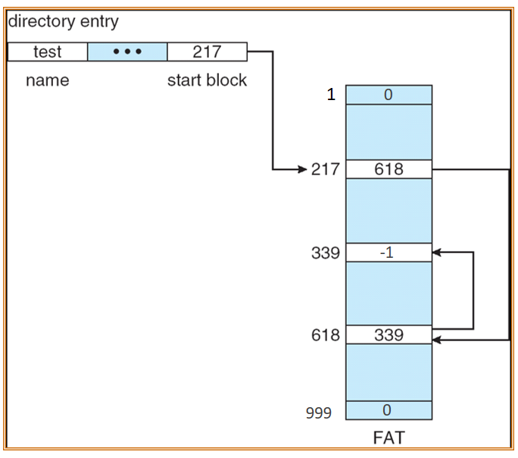
Variant of Linked Allocation
File Allocation Table (FAT)
The FAT has one entry for each disk block and is indexed by block number
The directory entry contains the block number of the first block of the file
The table entry indexed by the block number contains the block number of the next block in the file
The last block contains a special end-of-file value as the table entry
Unused blocks are indicated by a zero table value
To allocate a new block to a file
Find the first zero-valued table entry
Replace the previous end-of-file value with the block no. of the new block

Slide 10
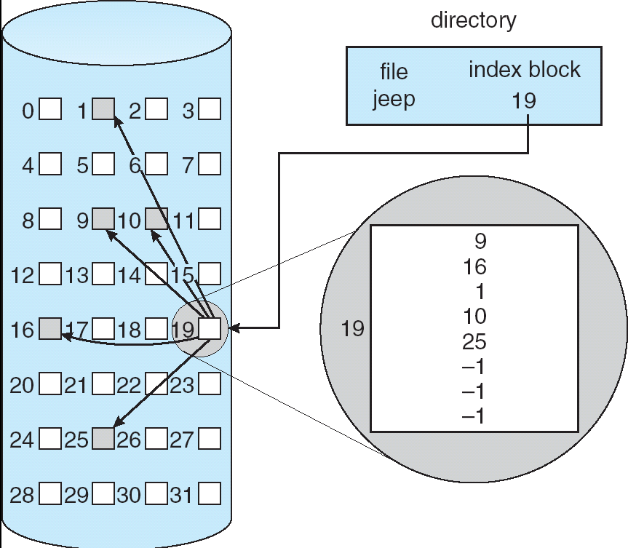
Indexed Allocation
Solves the problems of linked allocation by bringing all the pointers (for a file’s blocks) together into one location called the index block
Each file has its own index block, which is an array of pointers to disk blocks
Each entry in the index block points to the corresponding block of the file
The directory contains the address of the index block
Advantage: Supports direct access without suffering from external fragmentation
Disadvantage: Pointer overhead is more

Slide 11
Sizing of the Index Block
Approach #1: Linked scheme
Several index blocks can be linked together
Approach #2: Multilevel index scheme
A first-level index block points to a set of second-level index blocks
Approach #3: Combined scheme
Used in the UNIX file system
A specific set of pointers points directly to file blocks
Three special pointers
1st points to a single indirect block,
2nd points to a double indirect block, and
3rd points to a triple indirect block

Slide 12
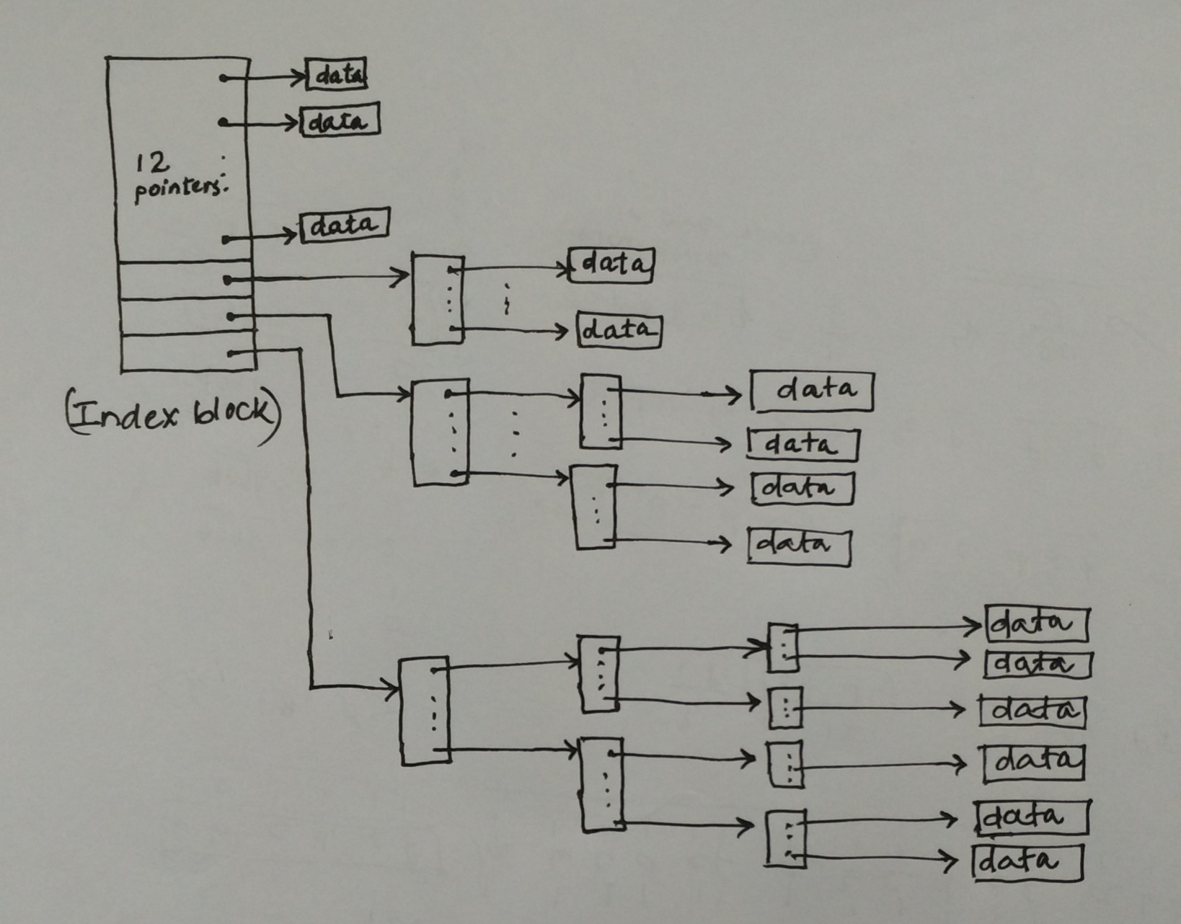
Sizing of the Index Block
Combined scheme

Slide 13
Free-Space Management
Bit Vector Approach
Linked List Approach
Grouping
Counting

Slide 14
Bit Vector Approach
Free-space blocks are tracked via a bit vector (where n = #blocks)
+ Simple to implement
+ Easy to find free blocks
- 40GB disk with 1KB block requires 5MB of bit-vector
- why to store the information about allocated blocks!!
0
1
2
n-1
…
0 ⇒ block[i] allocated
1 ⇒ block[i] free
bit[i] =


Slide 15
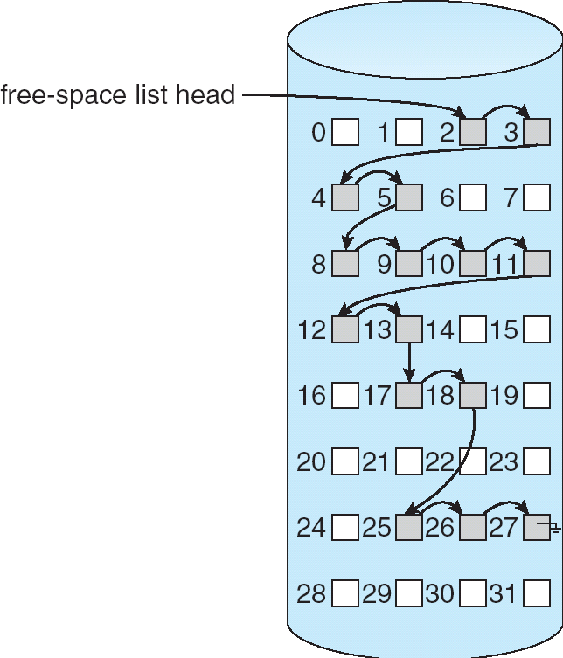
Linked List (free list) Approach

Slide 16
Grouping (modification of free list)
First free block stores the addresses of next n free
The first n–1 of these blocks are actually free
The last block contains the addresses of another n free blocks

Slide 17
Counting
Take advantage of the fact that several contiguous blocks may be allocated or freed simultaneously
No. of entries in the free space table is the number of free holes
Keep the address of the first free block and the number n of free contiguous blocks that follow the first block
Strat block of free hole | Size of free hole
2 | 4
8 | 6
17 | 2
25 | 3

